Slide 1
A Deep Learning Approach for the Coconut Tree Disease Detection
Munna Biswas
ID: 221-15-5261
Md. Monowar Hossain
ID : 221-15-5366
Department : CSE
Daffodil International University

Slide 2
Outline
Introduction
Objective
Background Study
Gap Analysis
Methodology
Results & Analysis
Novelty of the Work
Conclusion
References

Slide 3
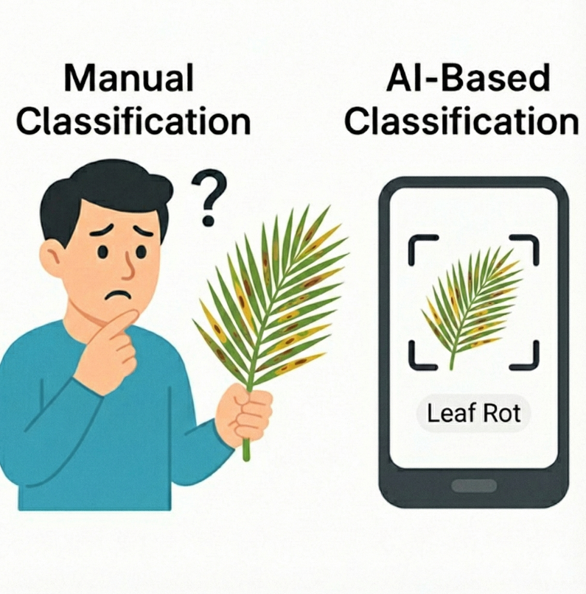
Introduction
The Problem: Coconut diseases such as Bud Rot, Leaf Rot, Yellow Leaf Disease, Coconut Caterpillar, and Stem Bleeding cause major agricultural losses. Manual disease identification is slow, inconsistent, and highly expertise-dependent.
The Solution: This project uses deep learning models to classify the disease accurately.
The Gap: There aren’t few diverse coconut datasets available, and most existing models don’t explain how they make their predictions.
The Goal: Identify accurate and lightweight models, and use XAI tools to make the system transparent and reliable for real-world use.
3

Slide 4
Objective
Develop an accurate coconut disease classifier using a lightweight transfer-learning model (MobileNetV2, MobileNetV3).
Build a high-quality dataset of five coconut diseases using real-world images collected from publicly available datasets.
Evaluate model performance using key metrics: Accuracy, Precision, Recall, and F1-Score, to identify the most efficient and reliable architecture.
Integrate Explainable AI (XAI) techniques (Grad-CAM, Grad-CAM ++)
4

Slide 5
Background Study
Why coconut disease detection matters?
Drawbacks of manual identification
Growth of machine vision & AI
What previous research achieved
Remaining challenges & need for this work
5

Slide 6
Similar Studies
Deep Learning disease detection: Many studies use deep learning models such as Faster R-CNN, SSD, YOLO, and various CNN architectures for pest identification, achieving strong performance ranging from 82% to 98% accuracy across different crops.
Use of Lightweight and Mobile-Friendly Models: Research highlights the effectiveness of efficient models like MobileNet and MobileNetV3 for real-time detection, proving that lightweight architectures can operate reliably in resource-limited field environments.
Real-Time Detection in Agriculture: Works using Faster R-CNN, SSD, and YOLOv5-S demonstrate that pest detection highlights the importance of reliable classification using deep learning models.
6

Slide 7
Similar Studies
Explainable AI in Botany: Recent research introduces Grad-CAM and similar visualization methods to interpret model decisions, making tree disease identification systems more transparent for botanical experts.
Challenges Noted in Previous Work: Studies often struggle with visual disease, cluttered backgrounds, and inconsistent lighting, emphasizing the need for robust preprocessing and augmentation; issues this project directly addresses.
7

Slide 8
Comparison Between Existing Works
Table 2.1: Summary of Literature Reviewed.
Author | Year | Title | Methodology | Key Findings
Subbaian et al. [1] | 2024 | Coconut leaf disease detection | YOLOv4 | Achieved 88% F1-score and 85% mAP for leaf disease detection.
Singh et al. [2] | 2021 | Coconut disease and pest detection | CNN, MobileNet, InceptionResNetV2 | Custom CNN achieved 96.94% accuracy.
Nivethitha et al. [5] | 2022 | Review on coconut disease detection | Deep Learning Review | Summarized CNN-based methods and challenges.
Muthulakshmi et al. [7] | 2025 | Coconut disease classification | DenseNet201, ResNet50, EfficientNetB0 | Achieved up to 99.85% accuracy.
George et al. [8] | 2023 | Early detection of stem bleeding | Color thresholding | Achieved 80.36% accuracy.
Table 1.1 Comparison Between Existing Works
8

Slide 9
Comparison Between Existing Works
Author | Year | Title | Methodology | Key Findings
Santhi & Murugan [12] | 2025 | Cocoscan: Precision diagnostics for coconut leaf disease | InceptionV3, Web App, XAI | Real-time disease diagnosis with XAI-based visual explanations for user trust
Pandian et al. [15] | 2022 | Plant disease detection using deep CNN | 14-layer custom DCNN | Achieved 99.97% accuracy with large augmented dataset across 58 disease classes.
Vidhanaarachchi et al. [21] | 2025 | Early diagnosis of coconut leaf wilt & caterpillar infestation | CNN, Mask R-CNN, YOLO | Achieved 90–97% disease accuracy and >95% caterpillar detection rate.
Table 1.1 Comparison Between Existing Works
9

Slide 10
Gap Analysis
Limited studies focus on coconut tree disease.
Datasets are limited or imbalanced, lacking real-world variation.
Heavy models dominate research; lightweight, mobile-friendly models are rarely explored.
XAI is missing in most works, making predictions hard to interpret.
Minimal multi-model comparison on a single dataset to identify the best architecture.
Lack of practical systems, such as deployable apps or user-facing interfaces.
Real-world challenges like diverse regions, lighting variation, and similar disease are not well addressed.
10

Slide 11
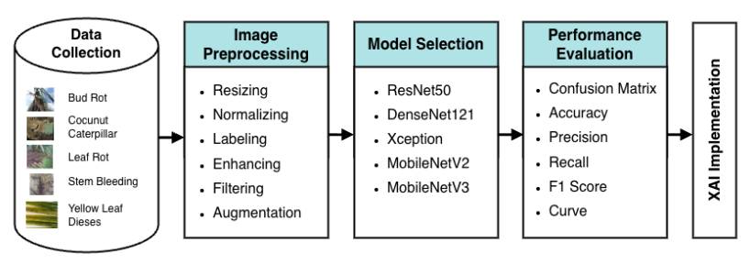
Methodology
Figure 1.1: Detailed Methodology Diagram
11

Slide 12
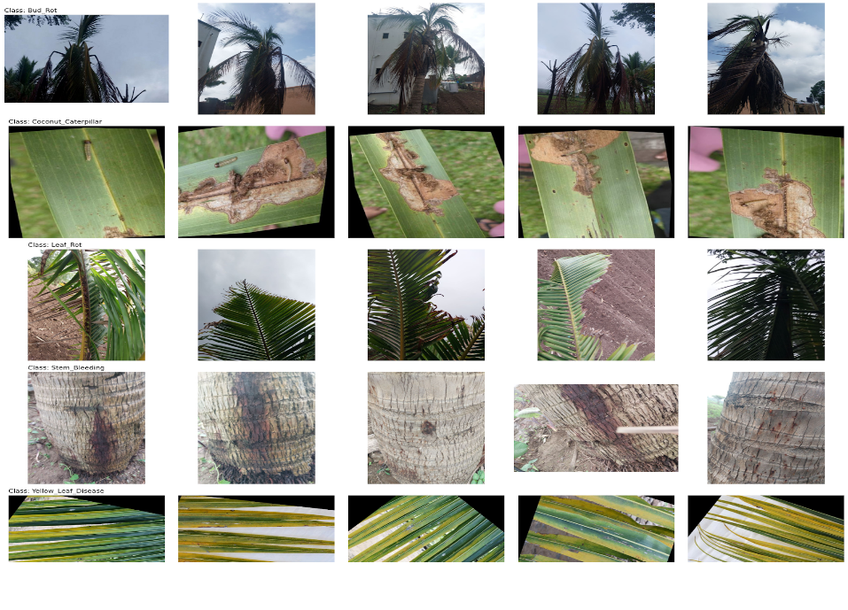
Methodology
Data Collection:
Data was collected from multiple publicly available online datasets.
Faced challenges with lighting variability and cluttered backgrounds, addressed through data preprocessing and cleaning.
Expanded the dataset to 5000 sample images after augmentation.
Figure 1.2: Sample images from each class.
12

Slide 13
Methodology
Image Preprocessing:
Resized images to 224 x 224 for uniform input.
Applied contrast enhancement and noise reduction.
Performed manual labeling for accurate class assignment.
Data Augmentation:
Techniques: rotation, width/height shift, zoom (≤20%), brightness adjustment, rescaling.
Enhanced dataset diversity without altering key features.
Expanded dataset to 5000 images evenly across 5 coconut diseases.
13

Slide 14
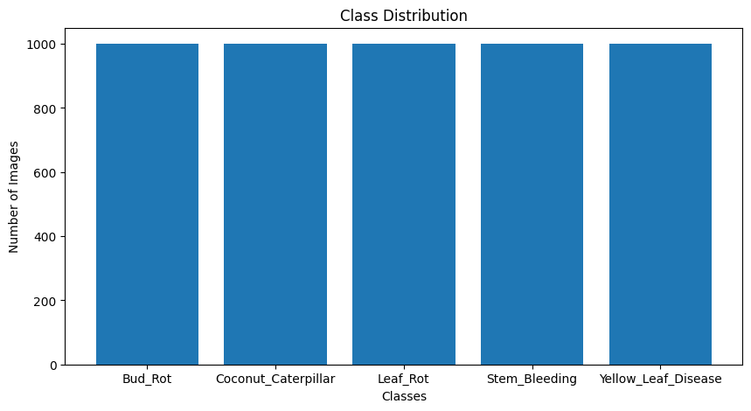

Methodology
Data Visualization
Figure 1.3: Class distribution after data augmentation
Figure 1.4: Sample images from each class (After Augmentation)
14

Slide 15
Methodology
The research used a systematic research process to come up with a reliable and scalable taxonomic system of the coconut leaf diseases. To begin with, related literature on the application of deep learning in the diagnosis of plant diseases was reviewed[1][2]. It involved CNN architectures[5], mobile-deployable lightweight models, ensemble learning, and Explainable AI technologies such as Grad-CAM[12]. The review allowed us to identify some of the key flaws of prior research, such as not having a balanced set of datasets, mistakenly grouped diseases, and models that are not user-friendly. The given methodology will aim to increase accuracy through fusion models, reduce computational requirements by using lightweight networks, balance the dataset, and provide explainability to strengthen trust in forecasting. Testing the performance, the comparison of various models, and making preparations to use it in real-time are also aspects of the methodology.
15

Slide 16
Methodology
Model Selection
II) Transfer Learning Models:
i) MobileNetV2
The MobileNetV2 is a small model that can be used to implement high-speed inferences and, therefore, can be deployed on mobile and real-time applications of disease recognition. It’s separable convolutions that can be computed depth-wise wise saving on a lot of computations, but offer high levels of accuracy as has been evident in the region of medicinal plant and general object classification [2][36]. MobileNetV2 plays an important role in our study as it is applied to assess the fast and efficient performance of classifications, which is relevant in cases when applications demand low-latency classifications.
16

Slide 17
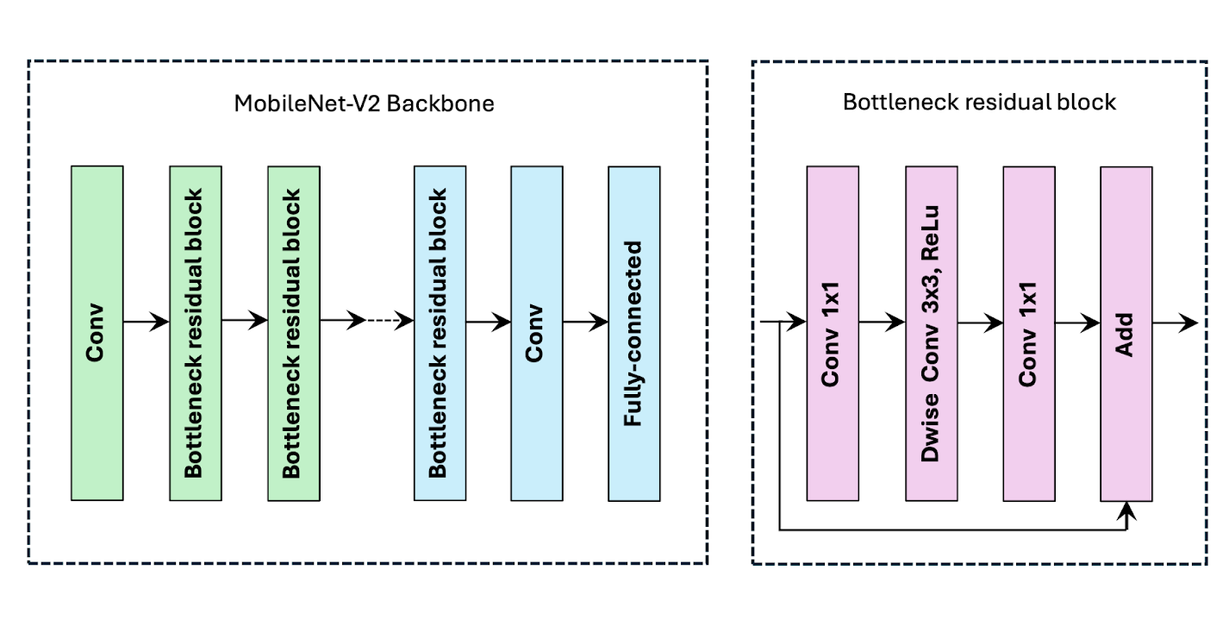
Methodology
Model Visualization
Figure 1.5: MobileNetV2 Architecture Diagram Mifthauddin et al.2025[36]
17

Slide 18
Methodology
Model Selection
II) Transfer Learning Models:
ii) MobileNetV3
MobileNetV3 will utilize MobileNetV2, although it includes the neural architecture search (NAS) and squeeze-and-excitation (SE) modules to enhance the network automatically. It is available in two sizes, Small and Large. The two are designed to be as efficient and precise as possible. MobileNetV3 is even more efficient in consuming computer resources than the former and performs better in a variety of benchmark datasets [36].
18

Slide 19
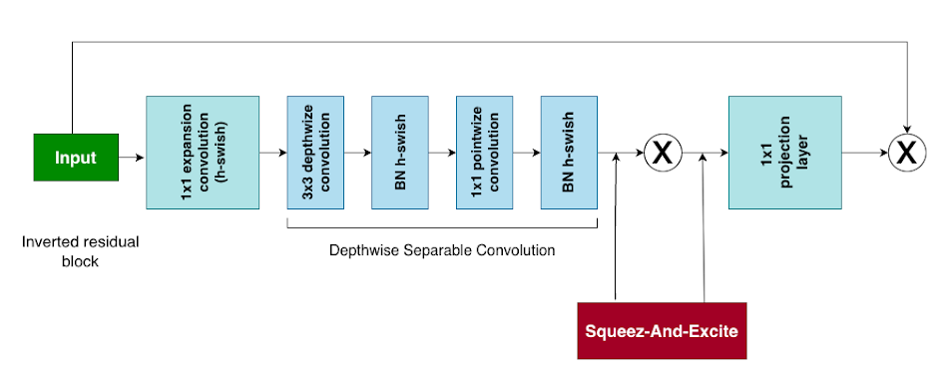
Methodology
Model Visualization
Figure 1.6: MobileNetV23 Architecture Mifthauddin et al.2025[36]]
19

Slide 20
Methodology
Model Selection
II) Transfer Learning Models:
iii) DenseNet121:
DenseNet121 is a convolutional net architecture that combines dense skip connections between all the layers. This design allows the feature maps to travel smoothly across the network, which accelerates gradient propagation and reduces the probability of the disappearance of the gradient during training. DenseNet121 promotes feature reuse, whereby earlier learned representations can be utilized by later layers. It is smaller in size and has fewer parameters than other deep architectures. DenseNet121 particularly performs well in tasks such as locating coconut disease since it is able to retain small information in leaf patterns, textures, and laceration forms. DenseNet121 is an effective backbone model in a variety of agricultural image classification tasks since it is efficient and able to generalize. A DenseNet121 architecture is shown in Figure 3.6 [34].
20

Slide 21
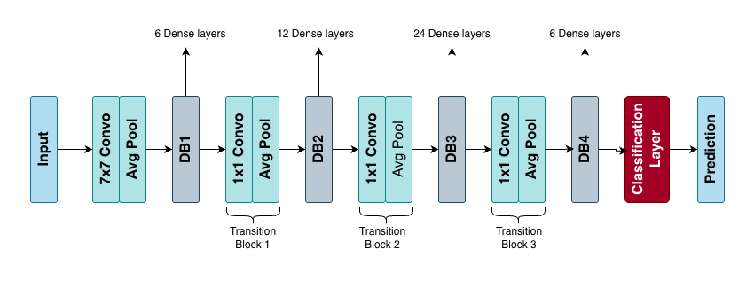
Methodology
Model Visualization
Figure 1.7: DenseNet121 Architecture.Diagram
Mifthauddin, et al.2025[34]
21

Slide 22
Methodology
Model Selection
II) Transfer Learning Models:
iv) ResNet50
The ResNet50 training system uses residual learning, which allows deep networks to be trained without vanishing gradients. It has proven to be efficient in bio-image and natural image classification in various studies, such as the classification of plant and crop species [35]. This study uses ResNet50 to assess the effectiveness of the skip-connection network in detecting the specific structural clues evident among various species of flowers.
22

Slide 23
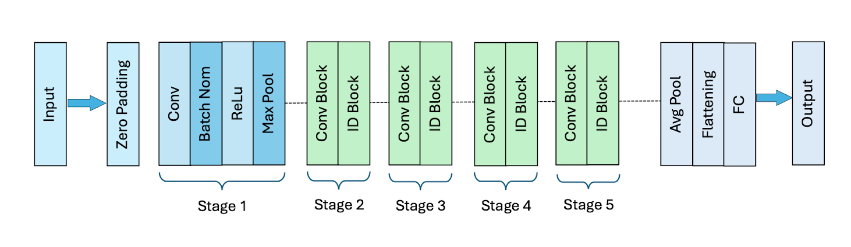
Methodology
Model Visualization
Figure 1.8: ResNet50 Architecture Diagram S. Mukherjee et al.2022[35]
23

Slide 24
Methodology
Model Selection
II) Transfer Learning Models:
v) Xception
Xception is a neural network that applies depth-wise separable convolution to learn very thin discriminative visual patterns. Previous research indicates that Xception performs better than conventional CNNs in the intricate image classification problems, such as flower and botanical [10][15]. It is best suited to extracting fine-grained patterns of species with similar colour tones or petal shapes. Xception is used in this work as a high-performance baseline in the assessment of an advanced model’s accuracy.
24

Slide 25
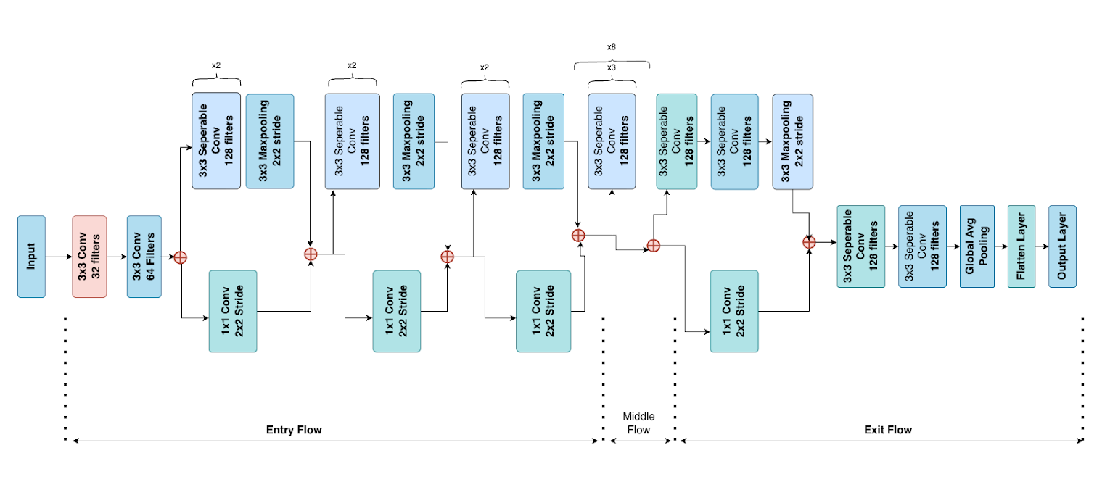
Methodology
Model Visualization
Figure 1.9: Xception Architecture Diagram K. Srinivasan et al.2021[37]
25

Slide 26
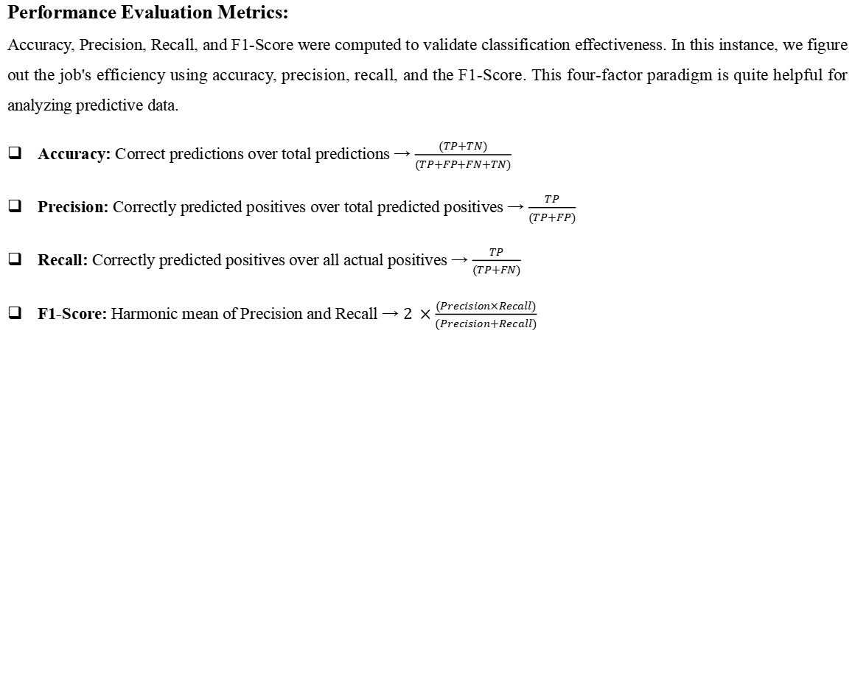
Methodology
Performance Evaluation Metrics:
Accuracy, Precision, Recall, and F1-Score were computed to validate classification effectiveness. In this instance, we figure out the job's efficiency using accuracy, precision, recall, and the F1-Score. This four-factor paradigm is quite helpful for analyzing predictive data.
Accuracy: Correct predictions over total predictions → $\frac{(TP+TN)}{(TP+FP+FN+TN)}$
Precision: Correctly predicted positives over total predicted positives → $\frac{TP}{(TP+FP)}$
Recall: Correctly predicted positives over all actual positives → $\frac{TP}{(TP+FN)}$
F1-Score: Harmonic mean of Precision and Recall → $2 ×\frac{(Precision×Recall​)}{(Precision+Recall)}$
26

Slide 27
Methodology
XAI Implementation (Explainable AI)
Added XAI to interpret how the model makes decisions, reducing the “black-box” nature of deep learning.
Helps users see which parts of the image influenced the prediction.
27

Slide 28
Methodology
XAI Techniques
Grad-CAM
Generates heatmaps highlighting important flower regions.
Most accurate & meaningful visualization among all methods.
Grad-CAM++
Provides finer, more detailed highlights.
Good localization but slightly less consistent than Grad-CAM.
LIME
Explains prediction by perturbing image segments.
Useful but produces more scattered highlights.
28

Slide 29
Result and Analysis
Model | Precision | Recall | F1-Score | Accuracy
MobileNetV2 | 0.99 | 0.99 | 0.99 | 98.70%
MobileNetV3 | 0.98 | 0.98 | 0.98 | 97.60%
DenseNet121 | 0.99 | 0.99 | 0.99 | 99.99%
ResNet50 | 1.00 | 1.00 | 1.00 | 99.98%
Xception | 0.99 | 0.99 | 0.99 | 98.69%
Table 1.2.: Result Table
29

Slide 30
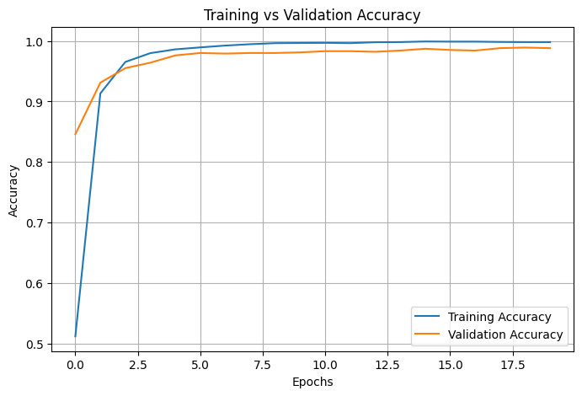
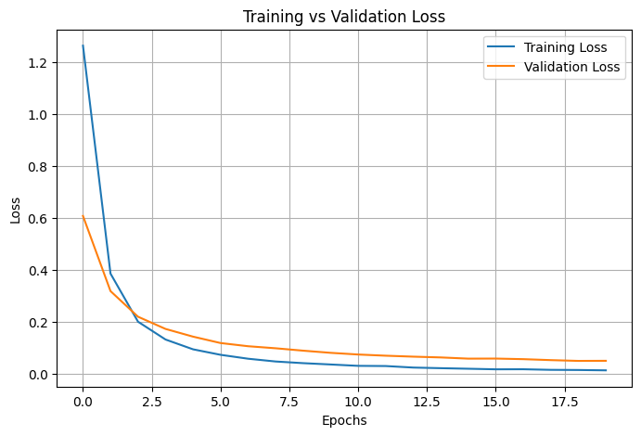
Result and Analysis
Figure 2.1(i): Accuracy & Loss Curve MobileNetV2
30

Slide 31
Result and Analysis
Class | Precision | Recall | F1-Score | Support
Bud_Rot | 0.96 | 1.00 | 0.98 | 200
Coconut_Caterpillar | 1.00 | 1.00 | 1.00 | 200
Leaf_Rot | 1.00 | 0.94 | 0.97 | 200
Stem_Bleeding | 1.00 | 1.00 | 1.00 | 200
Yellow_Leaf_Disease | 0.99 | 1.00 | 0.99 | 200
Accuracy |  |  | 0.99 | 1000
Macro avg | 0.99 | 0.99 | 0.99 | 1000
Weighted avg | 0.99 | 0.99 | 0.99 | 1000
Table 1.3: Classification report of MobileNetV2
31

Slide 32
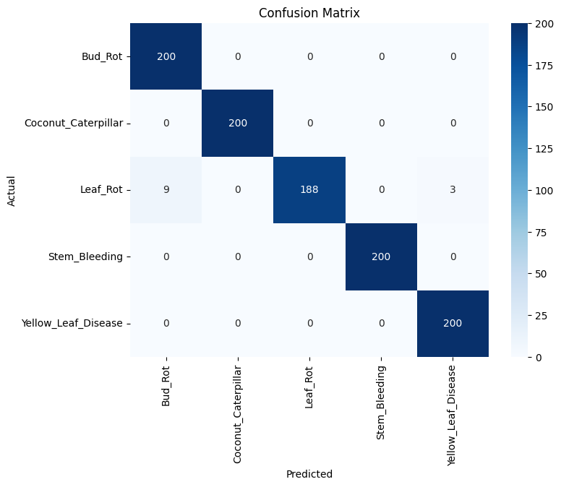
Result and Analysis
Figure 2.2(ii): Confusion Matrix MobileNetV2
32

Slide 33
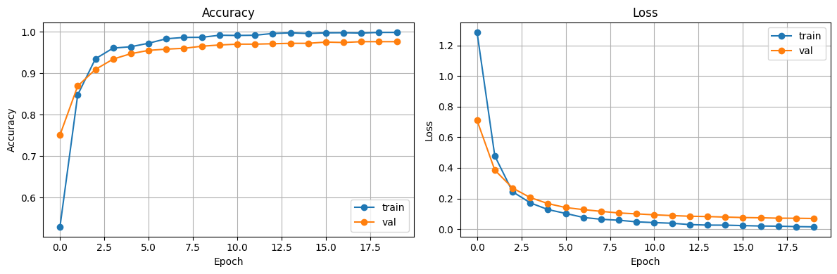
Result and Analysis
Figure 2.3(i): Accuracy & Loss Curve of MobileNetV3
33

Slide 34
Result and Analysis
Class | Precision | Recall | F1-Score | Support
Bud_Rot | 1.00 | 1.00 | 1.00 | 200
Coconut_Caterpillar | 0.96 | 1.00 | 0.98 | 200
Leaf_Rot | 0.99 | 0.93 | 0.96 | 200
Stem_Bleeding | 1.00 | 0.95 | 0.97 | 200
Yellow_Leaf_Disease | 0.93 | 1.00 | 0.97 | 200
Accuracy |  |  | 0.98 | 1000
Macro avg | 0.98 | 0.98 | 0.98 | 1000
Weighted avg | 0.98 | 0.98 | 0.98 | 1000
Table 1.4: Classification report of MobileNetV3
34

Slide 35
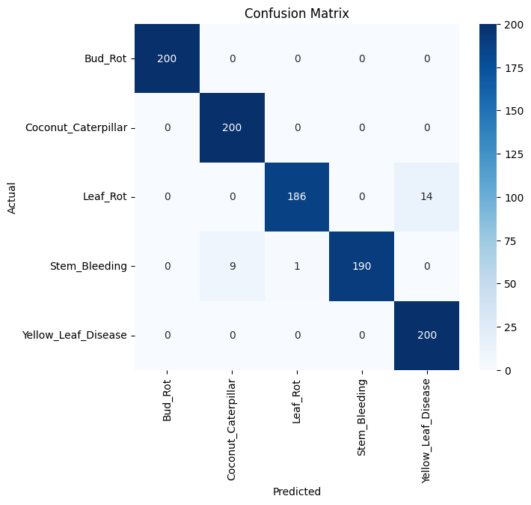
Result and Analysis
Figure 2.4(ii): Confusion Matrix (MobileNetV3)
35

Slide 36
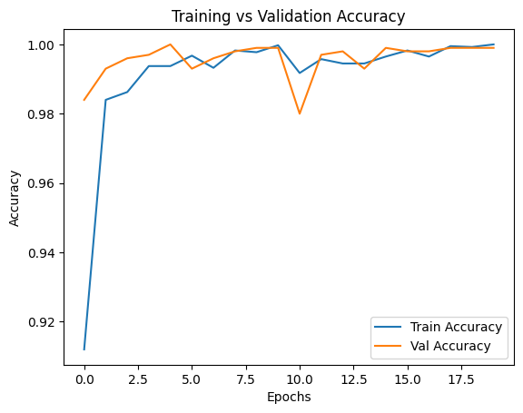
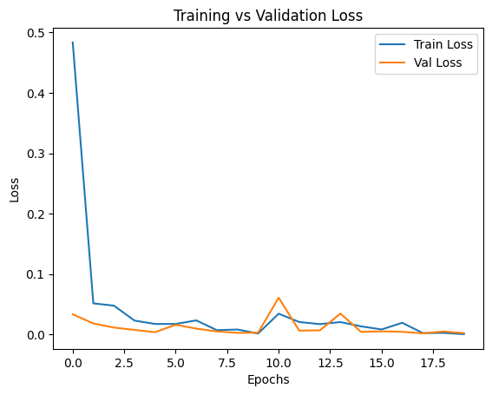
Result and Analysis
Figure 2.5(i): Accuracy & Loss Curve (DenseNet121)
36

Slide 37
Result and Analysis
Class | Precision | Recall | F1-Score | Support
Bud_Rot | 0.99 | 1.00 | 1.00 | 189
Coconut_Caterpillar | 1.00 | 1.00 | 1.00 | 191
Leaf_Rot | 1.00 | 1.00 | 1.00 | 213
Stem_Bleeding | 1.00 | 1.00 | 1.00 | 204
Yellow_Leaf_Disease | 1.00 | 1.00 | 1.00 | 203
Accuracy | 1.00 | 1.00 | 1.00 | 1000
Macro avg | 1.00 | 1.00 | 1.00 | 1000
Weighted avg | 1.00 | 1.00 | 1.00 | 1000
Table 1.5: Classification report of DenseNet121
37

Slide 38
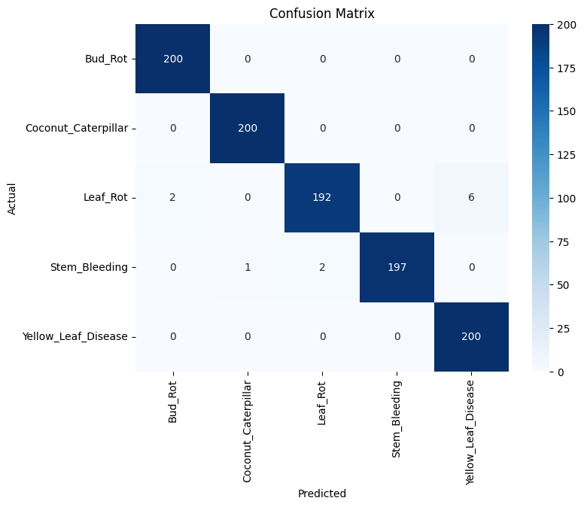
Result and Analysis
Figure 2.6(ii): Confusion Matrix (DenseNet121)
38

Slide 39
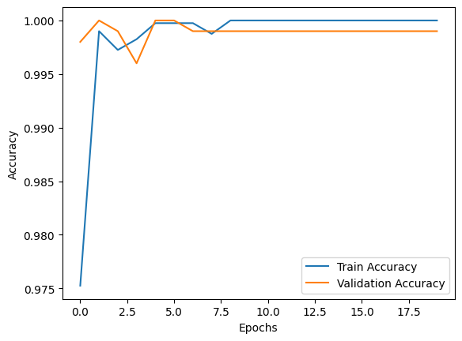
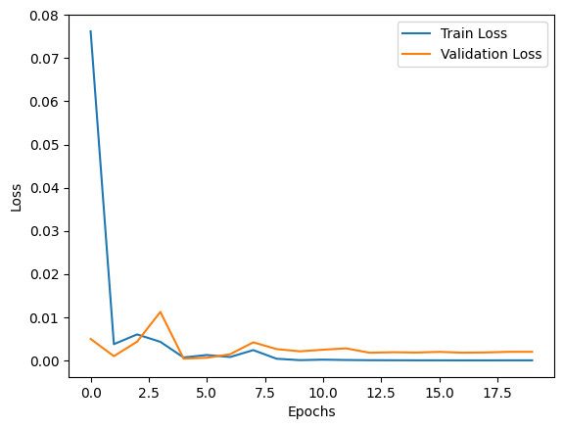
Result and Analysis
Figure 2.7(i): Accuracy & Loss Curve (ResNet50)
39

Slide 40
Result and Analysis
Class | Precision | Recall | F1-Score | Support
Bud_Rot | 1.00 | 1.00 | 1.00 | 189
Coconut_Caterpillar | 1.00 | 0.99 | 1.00 | 191
Leaf_Rot | 1.00 | 1.00 | 1.00 | 213
Stem_Bleeding | 1.00 | 1.00 | 1.00 | 204
Yellow_Leaf_Disease | 1.00 | 1.00 | 1.00 | 203
Accuracy | 1.00 | 1.00 | 1.00 | 1000
Macro avg | 1.00 | 1.00 | 1.00 | 1000
Weighted avg | 1.00 | 1.00 | 1.00 | 1000
Table 1.6: Classification report of (ResNet50)
40

Slide 41
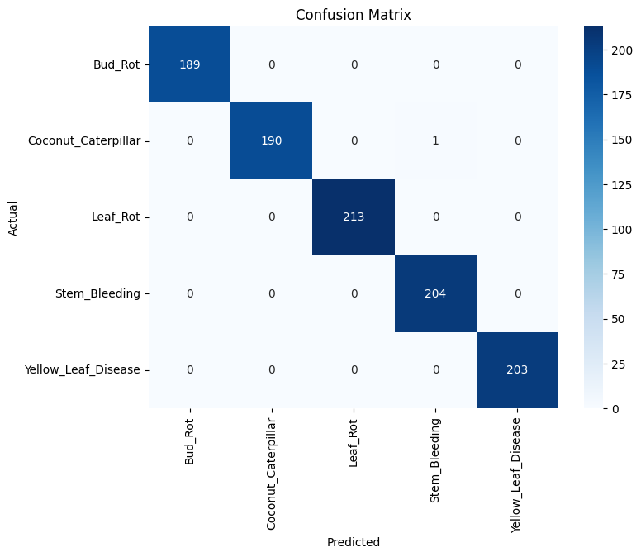
Result and Analysis
Figure 2.8(ii): Confusion Matrix of (ResNet50))
41

Slide 42
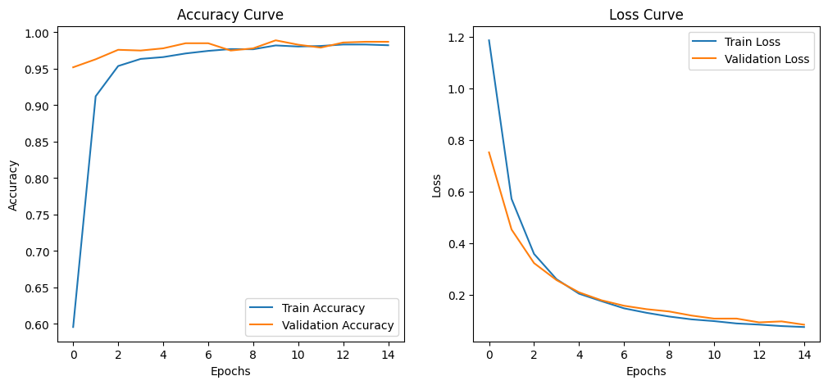
Result and Analysis
Figure 2.9(i): Accuracy & Loss Curve (Xception)
42

Slide 43
Result and Analysis
Class | Precision | Recall | F1-Score | Support
Bud_Rot | 0.99 | 0.99 | 0.99 | 200
Coconut_Caterpillar | 0.99 | 0.99 | 1.00 | 200
Leaf_Rot | 0.98 | 0.99 | 0.99 | 200
Stem_Bleeding | 1.00 | 0.97 | 0.99 | 200
Yellow_Leaf_Disease | 1.00 | 1.00 | 1.00 | 200
Accuracy |  |  | 0.99 | 1000
Macro avg | 0.99 | 0.99 | 0.99 | 1000
Weighted avg | 0.99 | 0.99 | 0.99 | 1000
Table 1.7: Classification report of (Xception)
43

Slide 44

Result and Analysis
Figure 2.10(ii): Confusion Matrix (Xception)
44

Slide 45
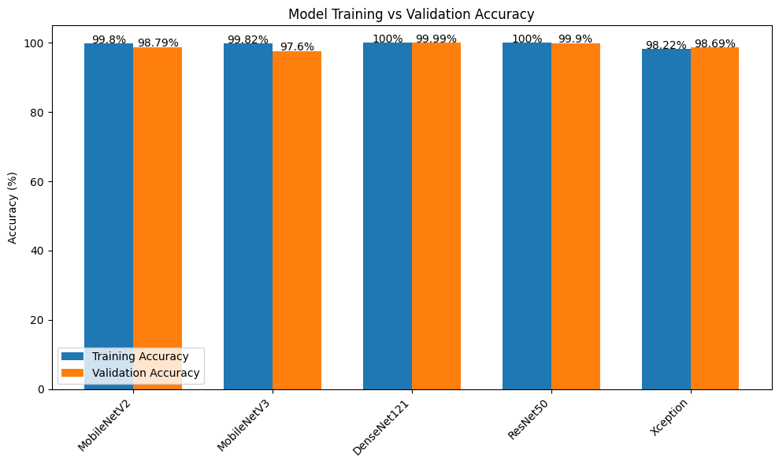
Result and Analysis
Figure 3.1: Comparison of accuracy between all models.
45

Slide 46
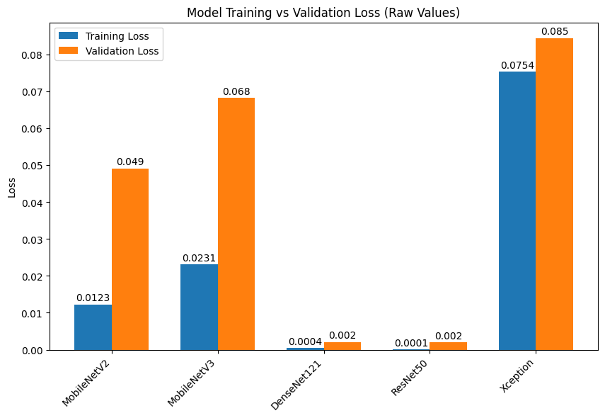
Result and Analysis
Figure 3.2: Comparison of loss between all models.
46

Slide 47
Result and Analysis
Explainable AI (XAI) Interpretation on MobileNetV2
Grad-CAM
Most accurate and stable visual explanations.
Heatmaps focused on true disease features (patterns, structure, colour regions).
Clearly distinguishes visually similar diseases (e.g., Leaf Rot vs Yellow Leaf).
Shows MobileNetV2 learns real biological cues, not background noise.
Reliable XAI method for this project.
47

Slide 48
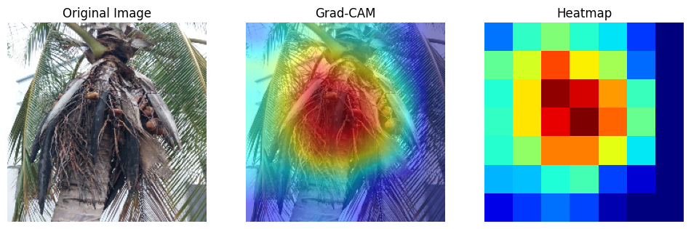
Result and Analysis
Explainable AI (XAI) Interpretation on MobileNetV2
Figure 3.3: Grad-CAM Interpretation (On Best Performer)
48

Slide 49
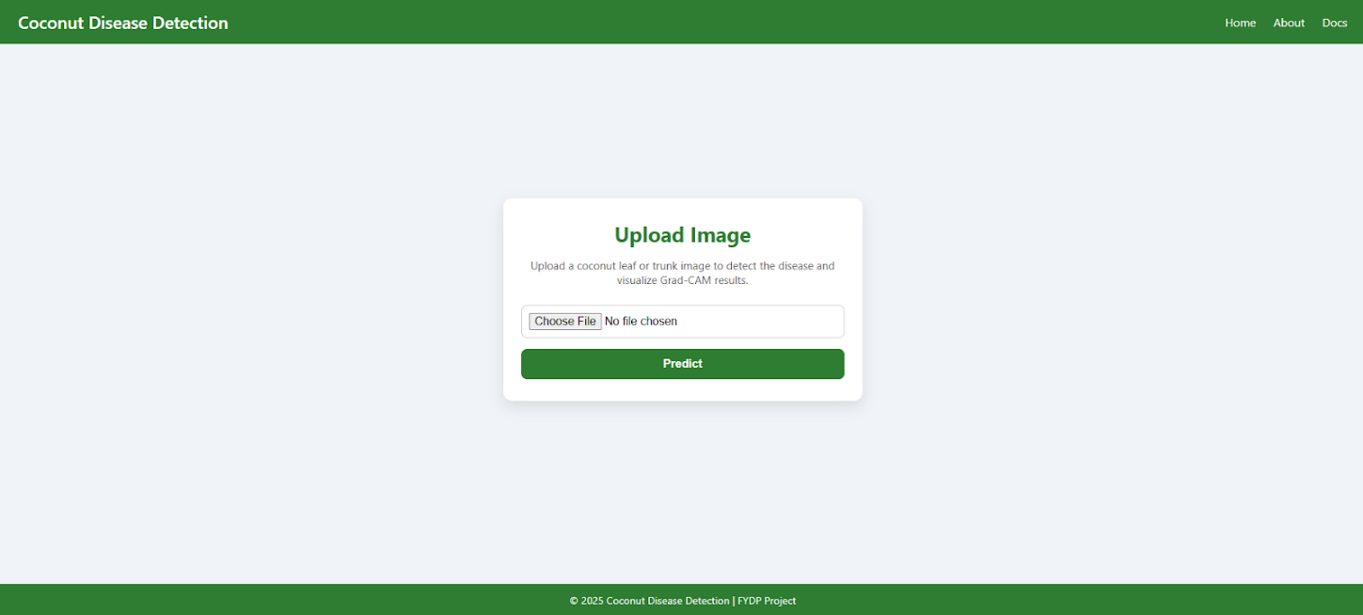
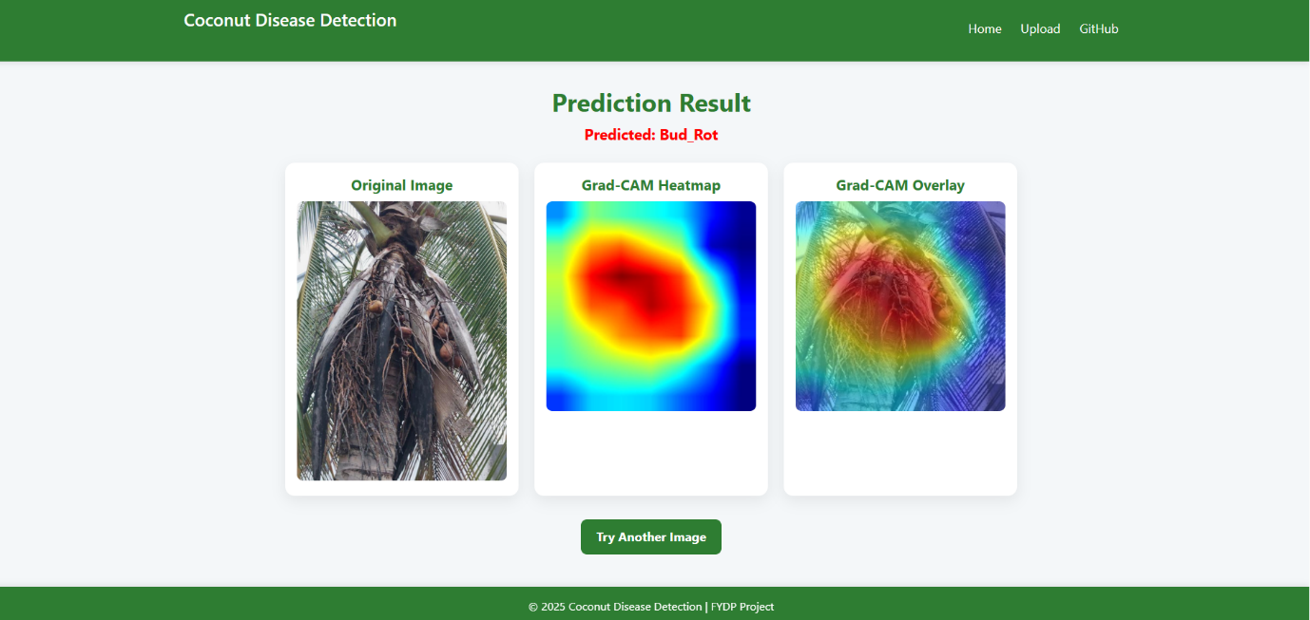
Web App Deployment
Figure 3.4: Web application home page.
Figure 3.5: Web application result page.
49

Slide 50
Novelty of the Work
Comparative evaluation of 5 deep learning models for coconut disease classification.
Integration of XAI (Grad-CAM) for transparent and interpretable predictions.
Identification of lightweight, high-accuracy models suitable for real-time use.
50

Slide 51
Conclusion
This research successfully developed an interpretable coconut disease detection system with a lightweight Transfer Learning model trained on a diverse dataset of 5000 images. MobileNetV2 emerged as the best-performing architecture, achieving 98.79% accuracy while remaining lightweight and deployment-friendly. The integration of the XAI technique Grad-CAM enhanced model transparency by revealing the visual cues used during prediction. The system was further implemented through a web application, demonstrating practical real-time usability. Overall, the project delivers an accurate, reliable, and explainable solution for automated coconut disease identification.
51

Slide 52
References
[1] Subbaian, S., Balasubramanian, A., Marimuthu, M., Chandrasekaran, S. and Muthusaravanan, G., 2024. Detection of coconut leaf diseases using enhanced deep learning techniques. Journal of Intelligent & Fuzzy Systems, 46(2), pp.5033-5045.
[2] Singh, P., Verma, A. and Alex, J.S.R., 2021. Disease and pest infection detection in coconut tree through deep learning techniques. Computers and electronics in agriculture, 182, p.105986.
[3] Brar, S.K., Sharma, R., Vats, S. and Kukreja, V., 2023, July. A smart approach to coconut leaf spot disease classification using computer vision and deep learning technique. In 2023 World Conference on Communication & Computing (WCONF) (pp. 1-6). IEEE.
[4] Thite, S., Suryawanshi, Y., Patil, K. and Chumchu, P., 2023. Coconut (Cocos nucifera) tree disease dataset: a dataset for disease detection and classification for machine learning applications. Data in Brief, 51, p.109690.
[5] Nivethitha, T., Vijayalakshmi, P., Jaya, J. and Shriram, S., 2022, November. A review on coconut tree and plant disease detection using various deep learning and convolutional neural network models. In 2022 International conference on smart and sustainable technologies in energy and power sectors (SSTEPS) (pp. 130-135). IEEE.
[6] Maray, M., Albraikan, A.A., Alotaibi, S.S., Alabdan, R., Al Duhayyim, M. and Al-Azzawi, W.K., 2022. Artificial intelligence-enabled coconut tree disease detection and classification model for smart agriculture. Computers and Electrical Engineering, 104, p.108399.
[7] Muthulakshmi, M., Prasad, D.V., Kartheek, M.V.S. and Bhagawan, N.S., 2025, January. Enhanced Coconut Tree Disease Classification Using ResNet50, EfficientNetB0, and DenseNet-201 with Comparative Analysis of Activation Functions. In 2025 International Conference on Next Generation Communication & Information Processing (INCIP) (pp. 363-367). IEEE.
[8] George, B., Thampi, L. and Thampi, L., 2023, August. Color-Based Thresholding for Early and Reliable Detection of Stem Bleeding in Coconut Trees. In 2023 9th International Conference on Smart Computing and Communications (ICSCC) (pp. 274-279). IEEE.
52

Slide 53
References
[9 Kavithamani, V. and UmaMaheswari, S., 2023. Investigation of Deep learning for whitefly identification in coconut tree leaves. Intelligent systems with applications, 20, p.200290.
[10] Karegowda, A.G., Vaishnavi, D. and Harshalatha, Y., 2024, November. Coconut Disease Detection using Traditional ML Classifiers with GLCM and SIFT Features. In 2024 8th International Conference on Computational System and Information Technology for Sustainable Solutions (CSITSS) (pp. 1-6). IEEE.
[11] Wijethunga, C.D., Ishanka, K.C., Parindya, S.D.N., Priyadarshani, T.J.N., Harshanath, B. and Rajapaksha, S., 2023. Coconut plant disease identified and management for agriculture crops using machine learning. International Journal Of Engineering And Management Research, 13(5), pp.79-88.
[12] Santhi, S. and Murugan, M., 2025, February. Cocoscan: AI-Powered Precision Diagnostics for Coconut Leaf Disease. In 2025 4th International Conference on Sentiment Analysis and Deep Learning (ICSADL) (pp. 1756-1762). IEEE.
[13] Anitha, B. and Santhi, S., 2023, March. Disease prediction in coconut leaves using deep learning. In 2023 international conference on sustainable computing and data communication systems (icscds) (pp. 258-264). IEEE.
[14] Toradmalle, D., Bhanushali, N., Dama, M. and Dhote, M., 2023, December. Deep Learning Framework for Early Detection of Diseases in Coconut Tree from Leaf Images. In 2023 6th International Conference on Advances in Science and Technology (ICAST) (pp. 137-142). IEEE.
[15] Pandian, J.A., Kumar, V.D., Geman, O., Hnatiuc, M., Arif, M. and Kanchanadevi, K., 2022. Plant disease detection using deep convolutional neural network. Applied Sciences, 12(14), p.6982.
[16] Kumar, S., Chaudhary, V. and Chandra, S.K., 2021. Plant disease detection using CNN. Turkish Journal of Computer and Mathematics Education, 12(12), pp.2106-2112.
53

Slide 54
References
[17] Lu, J., Tan, L. and Jiang, H., 2021. Review on convolutional neural network (CNN) applied to plant leaf disease classification. Agriculture, 11(8), p.707.
[18] Bedi, P. and Gole, P., 2021. Plant disease detection using hybrid model based on convolutional autoencoder and convolutional neural network. Artificial Intelligence in Agriculture, 5, pp.90-101.
[19] Falaschetti, L., Manoni, L., Di Leo, D., Pau, D., Tomaselli, V. and Turchetti, C., 2022. A CNN-based image detector for plant leaf diseases classification. HardwareX, 12, p.e00363.
[20] Thakur, P.S., Chaturvedi, S., Khanna, P., Sheorey, T. and Ojha, A., 2023. Vision transformer meets convolutional neural network for plant disease classification. Ecological Informatics, 77, p.102245.
[21] Vidhanaarachchi, S., Wijekoon, J.L., Abeysiriwardhana, W.S.P. and Wijesundara, M., 2025. Early Diagnosis and Severity Assessment of Weligama Coconut Leaf Wilt Disease and Coconut Caterpillar Infestation using Deep Learning-based Image Processing Techniques. IEEE Access.
[22] Sharma, A., Trivedi, N.K. and Sharma, A.K., 2024. Disease categorization and early detection in coconut leaves. In Artificial Intelligence and Information Technologies (pp. 156-162). CRC Press.
[23] Wijesinghe, H.D.M.U., Tharupath, K.M.C. and Jayasinghe, G.Y., 2025. Detecting Weligama coconut leaf wilt disease in coconut using UAV-based multispectral imaging and object-based classification. Journal of Plant Diseases and Protection, 132(4), pp.1-14.
[24] Kaur, A., Kukreja, V., Garg, N., Rajput, K. and Sharma, R., 2024, April. Multi-class classification of coconut leaf disease using fine-tuned resnet50 model. In 2024 IEEE 9th International Conference for Convergence in Technology (I2CT) (pp. 1-6). IEEE.
54

Slide 55
References
[25] Gopalakrishna, K.M. and Lingaraju, R.M., 2025. A prediction of coconut and coconut leaf disease using MobileNetV2 based classification. International Journal of Electrical and Computer Engineering (IJECE), 15(3), pp.2834-2844.
[26] Sharma, R., Kukreja, V., Kaushal, R.K., Bansal, A. and Kaur, A., 2022, October. Rice Leaf blight Disease detection using multi-classification deep learning model. In 2022 10th international conference on reliability, Infocom technologies and optimization (trends and future directions)(ICRITO) (pp. 1-5). IEEE.
[27] Bari, B.S., Islam, M.N., Rashid, M., Hasan, M.J., Razman, M.A.M., Musa, R.M., Ab Nasir, A.F. and Majeed, A.P.A., 2021. A real-time approach of diagnosing rice leaf disease using deep learning-based faster R-CNN framework. PeerJ Computer Science, 7, p.e432.
[28] Shafik, W., Tufail, A., De Silva Liyanage, C. and Apong, R.A.A.H.M., 2024. Using transfer learning-based plant disease classification and detection for sustainable agriculture. BMC Plant Biology, 24(1), p.136.
[29] Paymode, A.S. and Malode, V.B., 2022. Transfer learning for multi-crop leaf disease image classification using convolutional neural network VGG. Artificial Intelligence in Agriculture, 6, pp.23-33.
[30] Wani, J.A., Sharma, S., Muzamil, M., Ahmed, S., Sharma, S. and Singh, S., 2022. Machine learning and deep learning based computational techniques in automatic agricultural diseases detection: Methodologies, applications, and challenges. Archives of Computational methods in Engineering, 29(1), pp.641-677.
[31] Eunice, J., Popescu, D.E., Chowdary, M.K. and Hemanth, J., 2022. Deep learning-based leaf disease detection in crops using images for agricultural applications. Agronomy, 12(10), p.2395.
55

Slide 56
References
[32] S. Vidhanaarachchi, J. L. Wijekoon, W. A. S. P. Abeysiriwardhana and M. Wijesundara, "Early Diagnosis and Severity Assessment of Weligama Coconut Leaf Wilt Disease and Coconut Caterpillar Infestation Using Deep Learning-Based Image Processing Techniques," in IEEE Access, vol. 13, pp. 24463-24477, 2025, doi: 10.1109/ACCESS.2025.3537664.
[33] Sousa, J.V.M., de Almeida, V.R., Saraiva, A.A., Santos, D.B.S., Pimentel, P.M.C. and de Sousa, L.L., 2020. Classification of Pneumonia images on mobile devices with Quantized Neural Network. Research, Society and Development, 9(10), pp.e889108382-e889108382.
[34] Radwan, N., 2019. Leveraging sparse and dense features for reliable state estimation in urban environments (Doctoral dissertation, University of Freiburg, Freiburg im Breisgau, Germany).
[35] Mukherjee, S., 2022. The annotated resnet-50. Towards Data Science, 18.
[36] Mifthauddin, A., Lutfi, M. and Saadah, Z.N., 2025. Comparison of MobileNetv2 and MobileNetv3 architectures in rice leaf disease classification using transfer learning. Jurnal Mandiri IT, 14(2), pp.195-202.
[37] Murindanyi, S., Nakatumba-Nabende, J., Sanya, R., Nakibuule, R. and Katumba, A., 2024. Enhanced Infield Agriculture with Interpretable Machine Learning Approaches for Crop Classification. arXiv preprint arXiv:2408.12426.
56

Slide 57
A Deep Learning Approach for the Coconut Tree Disease Detection
THANK YOU
57

